Slide 1
Internet Basics

Slide 2
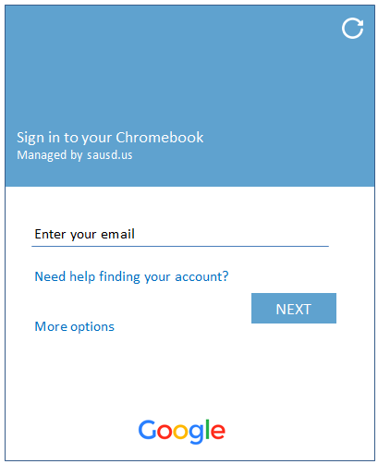
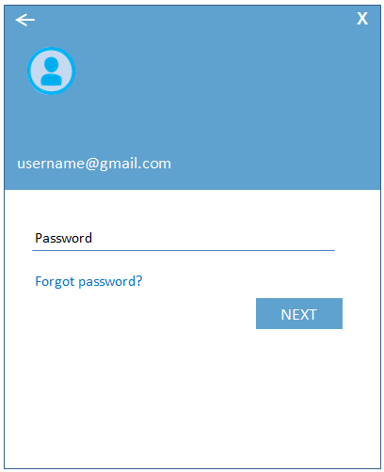
Log into the Chromebook
using the test account provided
Enter your Gmail username & Password provided on your handout.
Enter Gmail Username
& select Next
Enter Password
& select Next
Enter your Gmail
Username Only
Enter your Password
Notes:
Here is where we will have parents turn on the chromebook and now login. This screen is only for the day of the Digital Citizenship Academy. Parents will log in using the test student accounts provided.

Slide 3
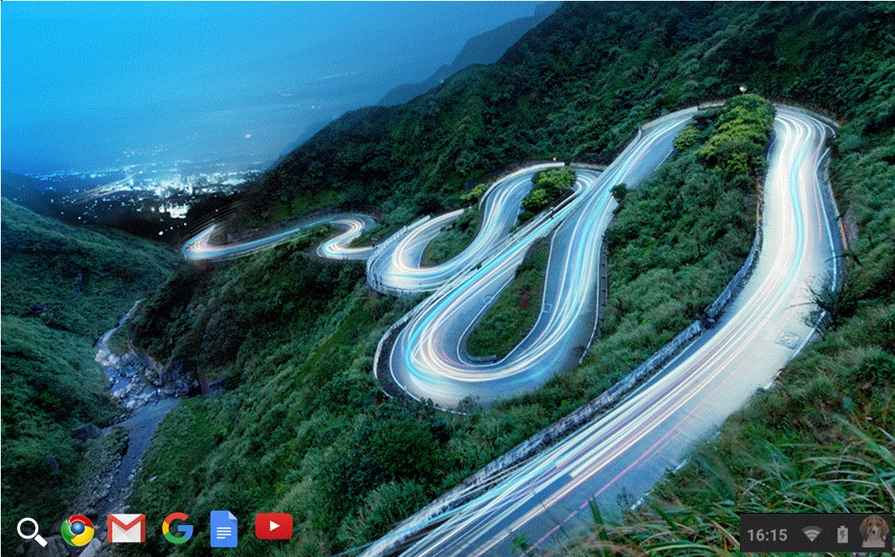
Screen After Logging In
Click in the lower left corner on Google Chrome
Notes:
Have the users hover mouse cursor over Google Chrome, Gmail, Google Docs, Youtube – don’t click!
Have users go back to Google and click

Slide 4
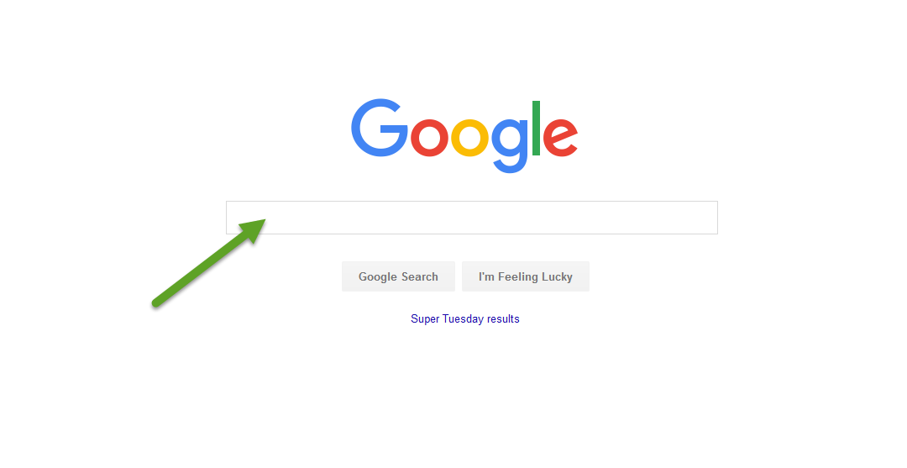
vs. Google Search
The Address bar
Notes:
Explain how they can search for anything by typing in the Google search field. Even a question can be typed into search. The address bar is used to type a url (for example: www.sausd.us)
Most popular top level domains? .com, .org, .net
Have them type in Sausd.us to go to the district webpage for the next slide

Slide 5
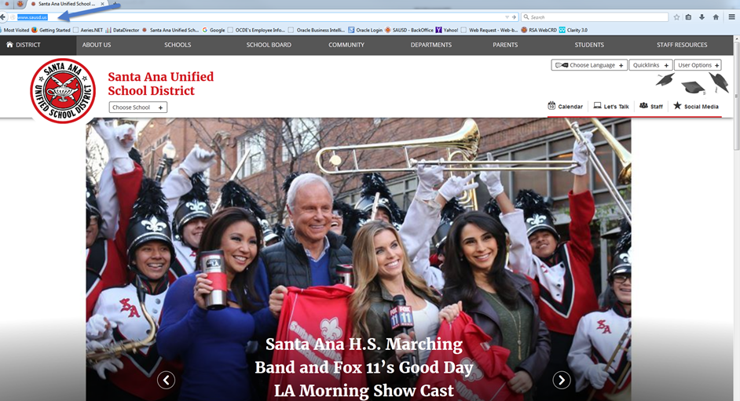
Let’s practice…with SAUSD resources
Online Resources for You and Your Family
Type www.sausd.us in the address bar (top left corner of your page)
Then click Enter on your keyboard after you have typed in the website address. This is the main webpage for all of the Santa Ana Unified School District.

Slide 6
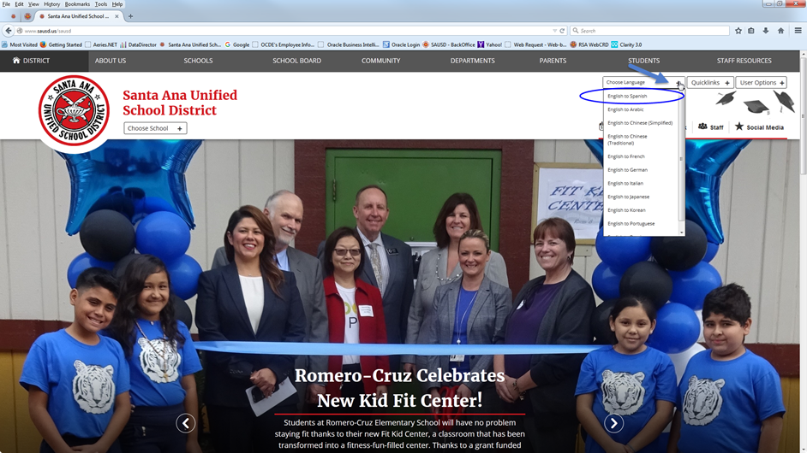
Choose Language preferences
Click on “Choose Language” in the top right corner of the page.
Select and click “English to Spanish”

Slide 7
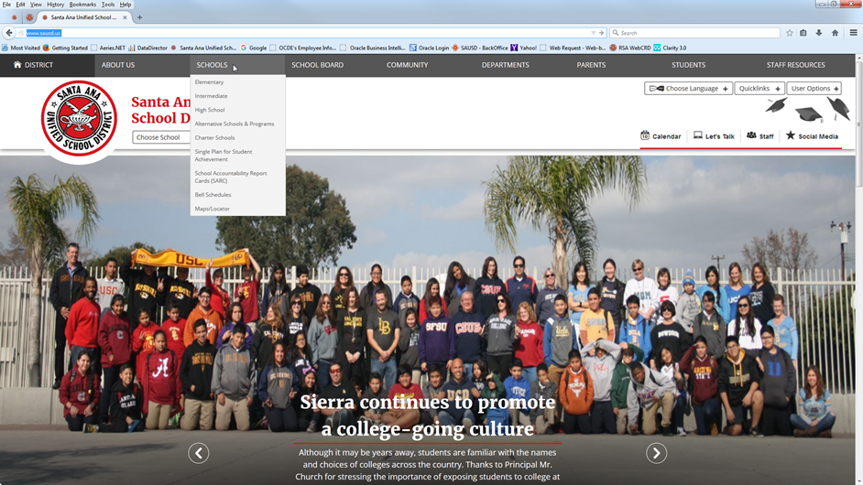
Find your child’s school webpage
Click on SCHOOLS

Slide 8
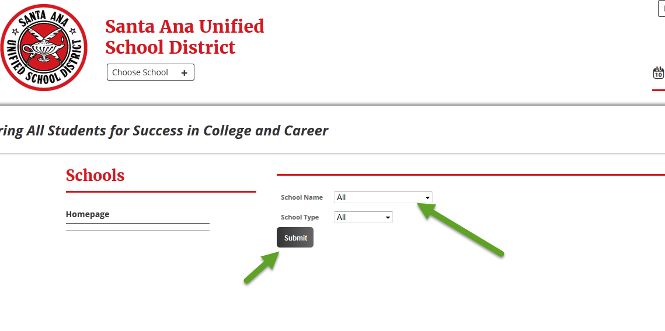
Find the name of your school
Click on the triangle to open the list of school names.
Click on the name of your child’s school.
The schools are listed in alphabetical order.
Click the button once you have found the name of the school.
Submit

Slide 9
Learn about your child’s school
Let’s have a Scavenger Hunt...
Find the following 4 items on the school’s webpage:
What is the name of the school’s principal?
What is the phone # of the school?
Where is the school calendar?
What is one current event happening at the school?

Slide 10
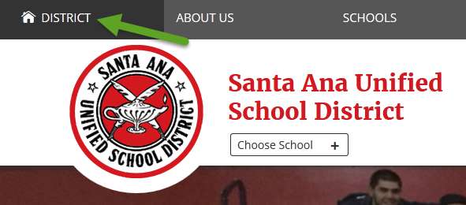
Return to the SAUSD District webpage
Click on District in the top left corner.
2. Once you are on the District’s main webpage, click on Parents in the top right corner.
Notes:
Remind parents to click in the top left corner on District then on Parent.

Slide 11
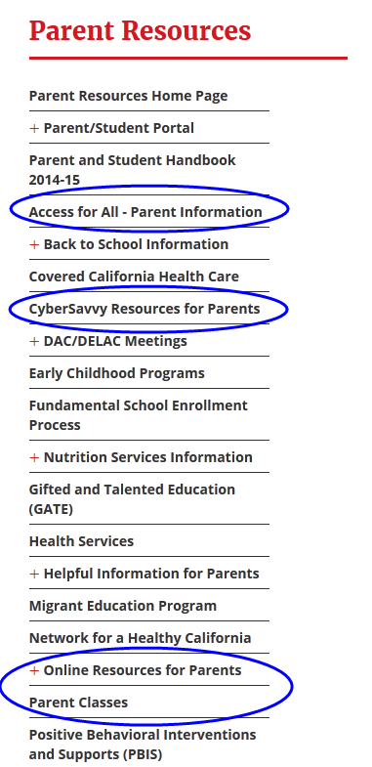
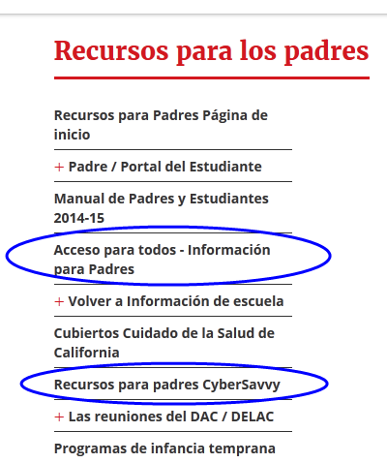
SAUSD Parent Resources
http://www.sausd.us/domain/12
Notes:
point out the cyber savvy link and the parent internet resources page

Slide 12
Notes:
End of class 2.. Ask if there are any questions or comments.

